Slide 1
CONNECT - Upskilling of sChools’ teachers to effectively support ONliNe EduCaTion
KA2 - Agreement Number : 2020-1-EL01-KA226-SCH-094578
CONNECT
Presentation

Slide 2
General
Target Call: Erasmus+ 2020 - Strategic partnerships in response of the COVID-19 situation
Target Priority: Partnerships for Digital Education Readiness (in the fields of school education, vocational education and training, and higher education). These projects aim at equipping education and training systems to face the challenges presented by the recent sudden shift to online and distance learning, including supporting teachers to develop digital competences and safeguarding the inclusive nature of learning opportunities
CONNECT
Upskilling of sChools’ teachers to effectively support ONliNe EduCaTion
28 months project (March 2021 – June 2023)
Hellenic National Agency / IKY

Slide 3
Consortium
Leading organization
Regional Directorate for Primary and Secondary Education (Greece)
Partners
Computer Technology and Institute and Press “Diophantus” (Greece)
Institute for Educational Technology (Italy)
University of Cyprus (Cyprus)

Slide 4
CONNECT (1)
Topics addressed
ICT – new technologies – digital competences
Open and distance learning
Pedagogy and didactics
Target group
Teachers and students of secondary schools
Policy makers involved in school education
Pedagogical institutions
Organizations and associations related to school education

Slide 5
CONNECT (2)
Objectives
To develop the digital pedagogical competences of teachers, enabling them to deliver high quality online courses based on novel educational scenarios.
To make teachers aware of how to best incorporate digital online technology into subject-specific teaching and learning: Language, Physics and Mathematics
To increase the teachers’ and schools’ interest, especially during the post-COVID19 period, in using ICT for online education, by publishing good practices and teacher guidelines in online education among students and teachers.

Slide 6
CONNECT (3)
Methodological approach
5 Intellectual Outputs (IOs)
A study depicting the European educational landscape during the COVID-19 crisis.
A pedagogical framework underpinning the online delivery of courses in secondary schools in addition to the in-class activities.
Development of educational scenarios
A core educational scenario for incorporating digital online technology into teaching and learning
24 educational scenarios for the subject-specific teaching of Language (8 scenarios), Physics (8 scenarios) and Mathematics (8 scenarios) according to the blended learning model.
Α MOOC for teachers upskilling on using digital technology for online education
Teacher’s guide
Recommendations for the adoption and exploitation of CONNECT approach
A face to face training event targeting at least 24 teachers from European schools
Multiplier Events
1 European and 2 National
Build a network of ambassadors

Slide 7
CONNECT (4)
Milestones
December 2021
IO1 - A public report and the pedagogical framework
February 2022
IO2 - A core educational scenario and 24 educational scenarios for the teaching of Language, Physics and Mathematics
September - November 2022
MOOC training
December 2022 – February 2023
A F2F training event @Athens
European Multiplier Event @Athens
Piloting of educational scenarios and online courses at school level
National Multiplier Events @Cyprus, @Palermo
Final teacher’s guide
June 2023
The exploitation plan that will present preconditions and recommendations for the adoption of CONNECT main outputs

Slide 8
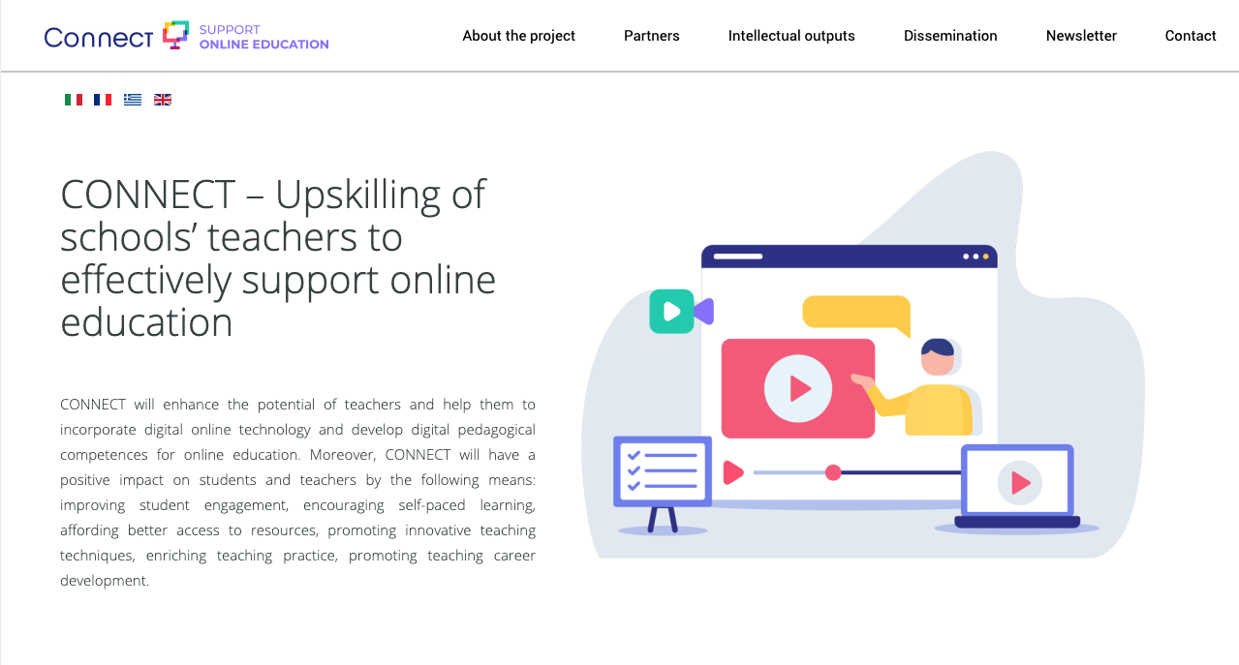
CONNECT (5)
Project Website
https://connect-erasmusproject.eu/index.php/en/
Social Media
https://twitter.com/CErasmusproject
@CErasmusproject
https://www.facebook.com/ConnectErasmusProject
#ConnectErasmusProject

Slide 9
Thank you!
Thomas Zarouchas | CONNECT
zarouchas@cti.gr

